Slide 1
Multi-Robot Coordination and Planning https://github.com/draghicivlad/mas-lab

Slide 2
Problem formulation
MAPF with N agents, M dynamic, and K static obstacles can be defined as a tuple: ⟨A, G(V, E), Odyn, Ostatic, S, Go⟩, where:
A = (A1, ..., AN) – a set of N agents
G = (V, E) – a graph that represents the whole map environment
Odyn = (O1, ..., OM) – a set of M dynamic obstacles
Ostatic = (O1, ..., OK) – a set of static obstacles
S = (s1, ..., sN) – encodes the initial state of the system (agents)
Go = (g1, ..., gN) – defines a set of goals
The vertices ∀Vi ∈ V can be occupied by any agents ∀An ∈ A or any obstacles ∀Om ∈ Odyn and ∀Ok ∈ Ostatic. The agents and dynamic obstacles can move from Vi to Vj, ∀Vi, Vj ∈ V through Eij ∈ E.

Slide 3
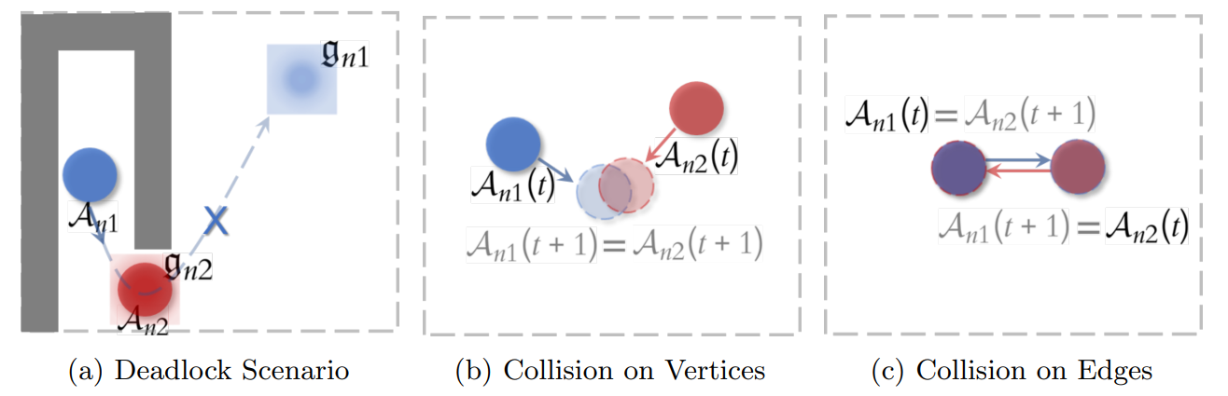
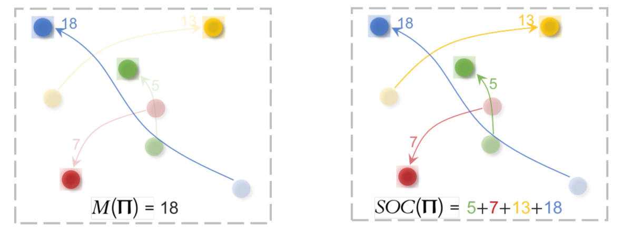
Problem formulation

Slide 4
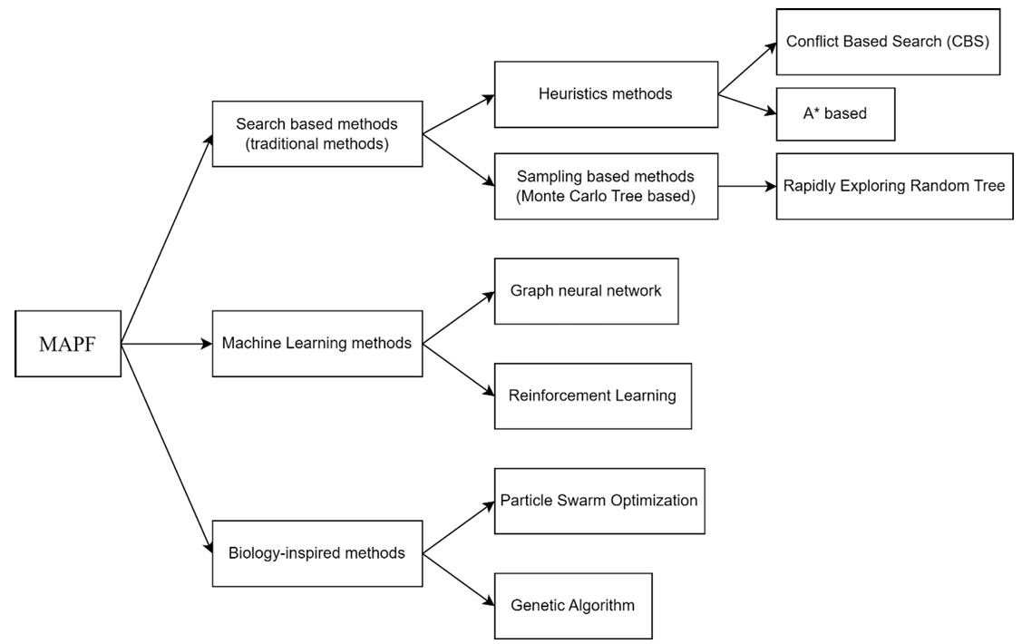
Problem formulation

Slide 5
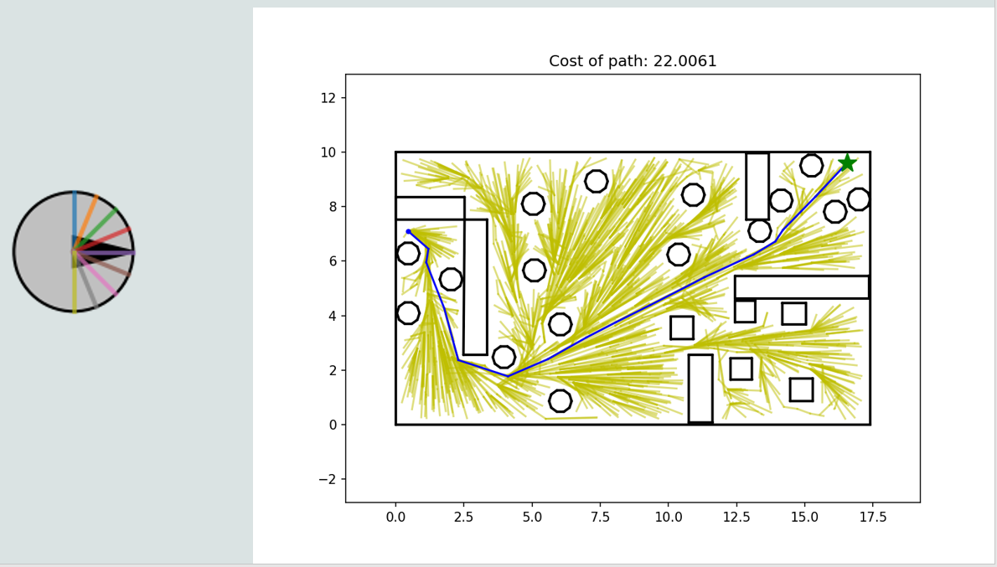
RRT*

Slide 6
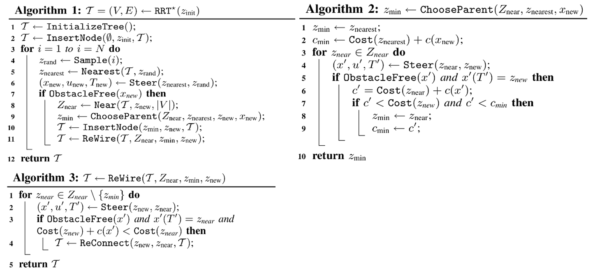

Slide 7
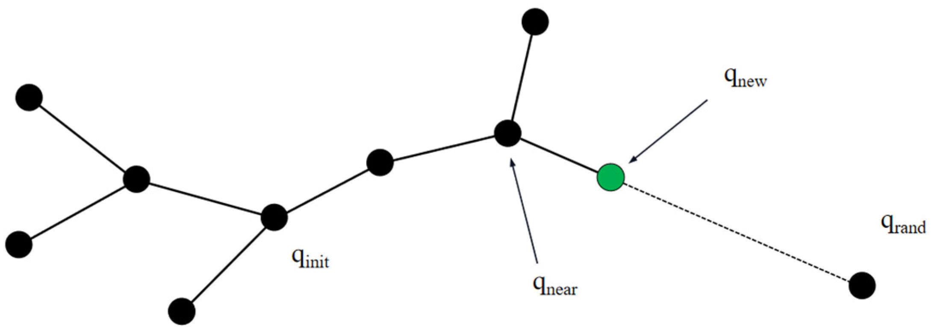
RRT*

Slide 8
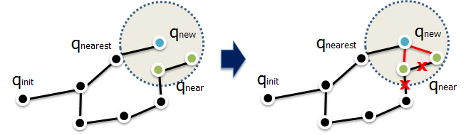
RRT*

Slide 9
Problem formulation
Input:
G – grid environment where G[x,y] = -1 means there is an obstacle at position (x, y)
N – number of robots M – number of tasks
R – list of the position of each robot
T – list of the position of each task
D – list of task dependences (Some tasks require certain predecessors to finish first)
Output:
A – assignment of each task to a robot
C – total cost of the assignment

Slide 10
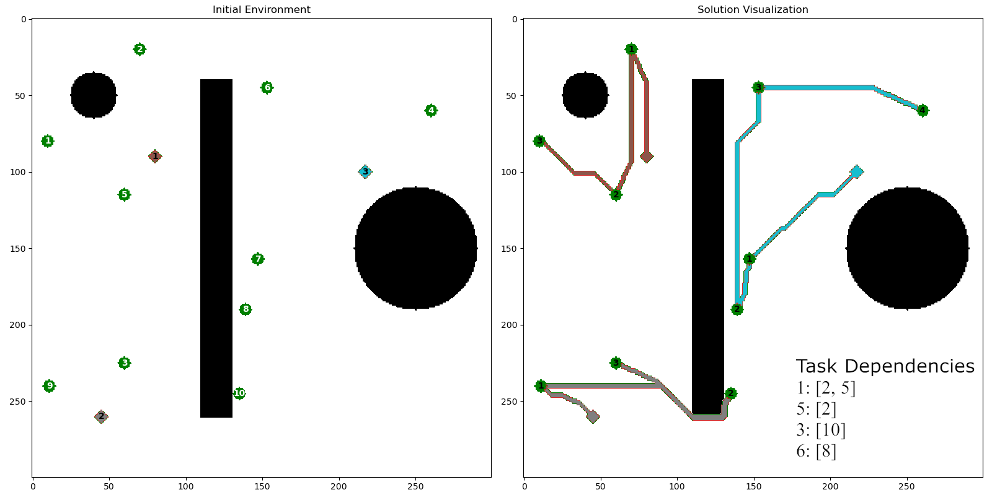
Small Environment

Slide 11
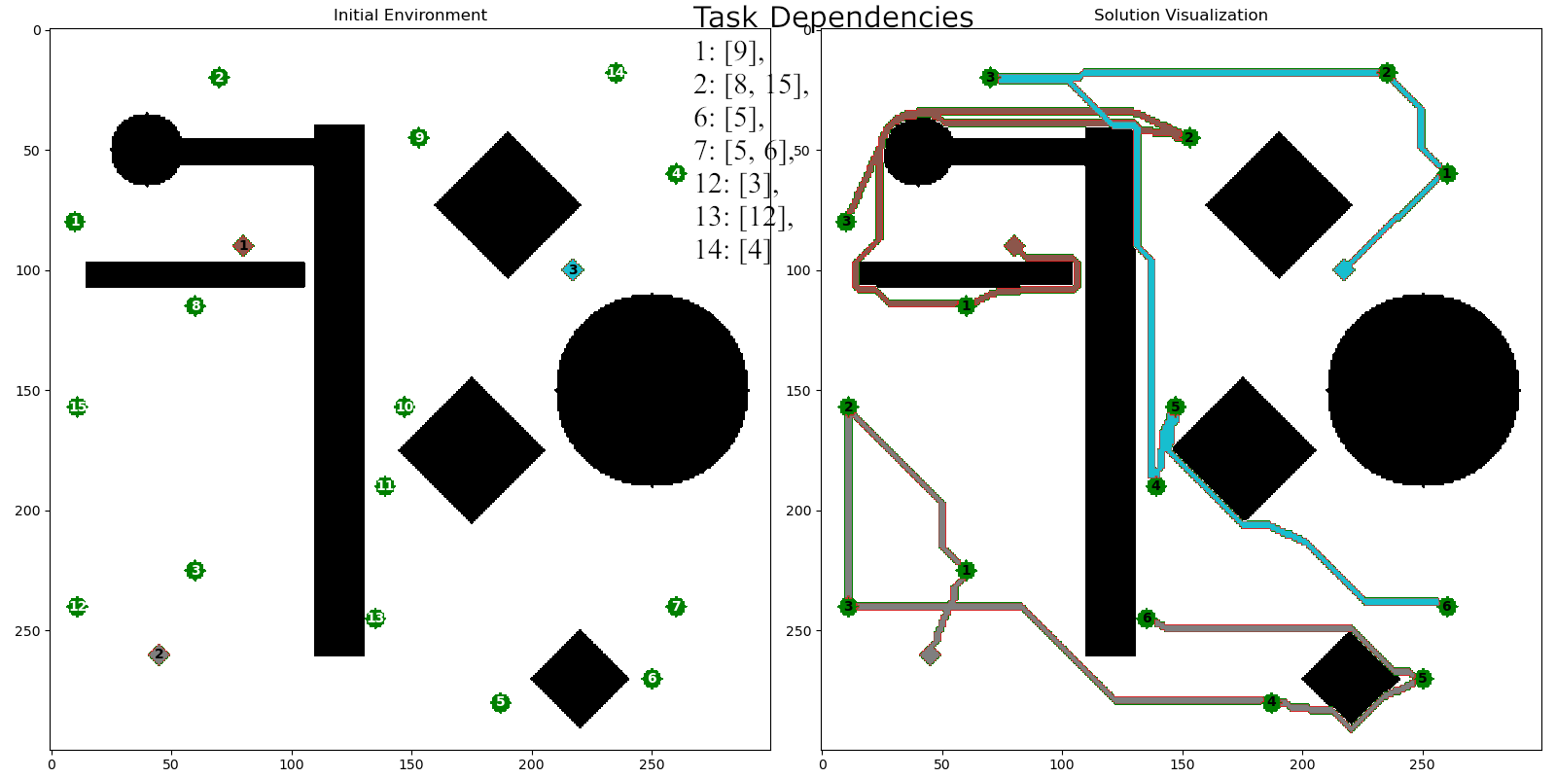
Big Environment

Slide 12
ACO without dependences
Steps:
Initialization: Start with uniform pheromone on robot–task assignments.
Solution Construction
For each task, probabilistically pick a robot based on pheromone levels and distance heuristic.
Robot routes are then formed, and total travel cost is calculated.
Pheromone Update
Evaporation: reduce old trails by a factor (1−ρ).
Deposition: strengthen assignments used by the best solution.
Iteration
Repeat until convergence or max iterations.
Outcome:
Minimizes sum of distances for all tasks (no precedence constraints).

Slide 13
ACO with dependences
Topological Solution Construction
Available Tasks: tasks with all prerequisites met (in-degree = 0).
Ant Chooses Task: randomly select one from available list.
Assign Robot: pick robot based on pheromone and distance heuristic.
Update: Remove chosen task from available; decrement in-degree of dependent tasks.
Scheduling Cost
Each task’s finishing time depends on:
Robot’s prior tasks.
Prerequisite tasks’ finishing times.
Objective: minimize sum of finishing times.
Pheromone Update
Similar evaporation and deposit steps.
Infeasible solutions (cyclic dependencies) get infinite cost.
Result: Feasible schedules respecting all prerequisites, with reduced total finishing time.

Slide 14
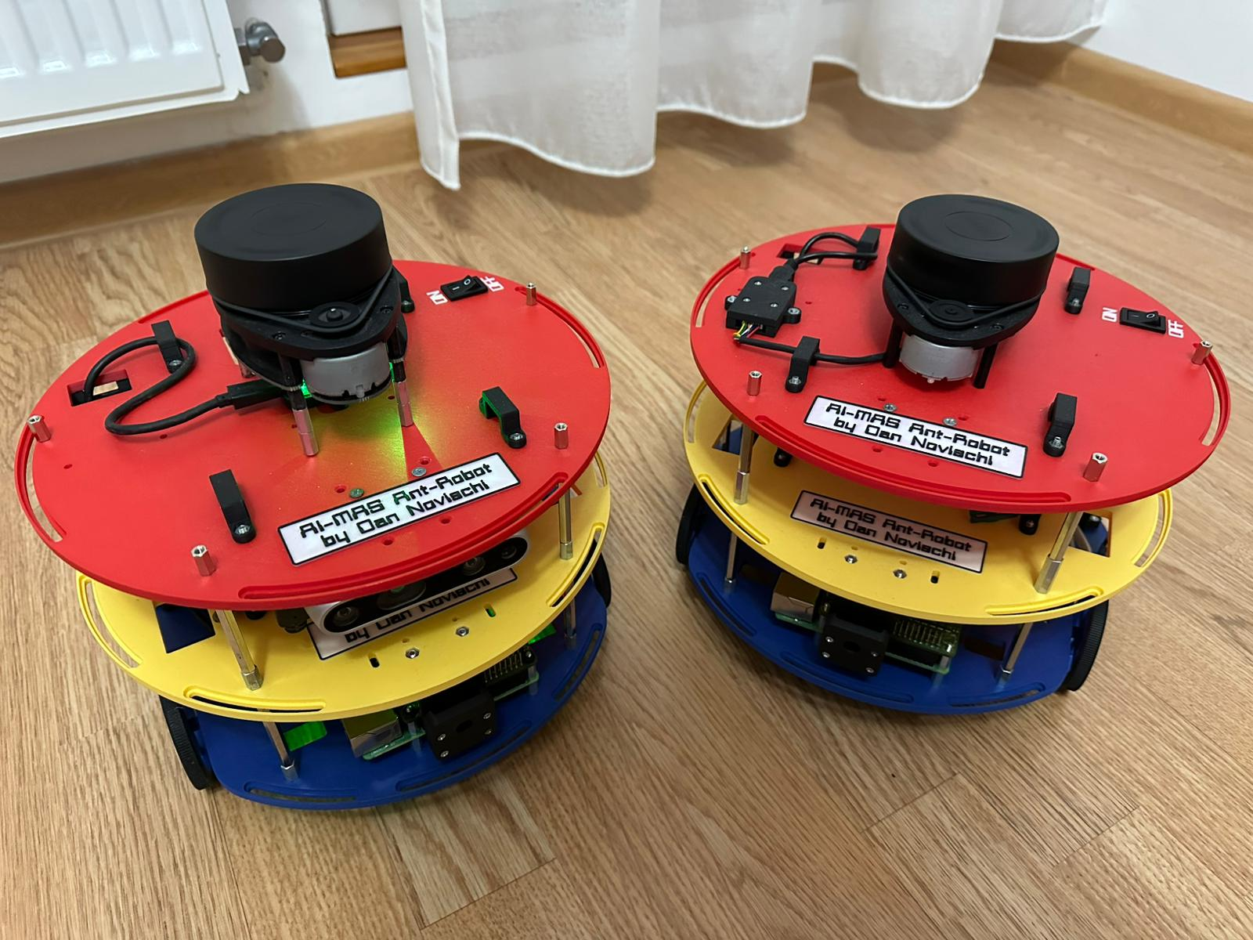
The physical robots
Robot components:
Chassis
Drive Wheels
Caster Wheel
Motors
Motor Controller
Battery and Power Supply
LiDAR Sensor
Raspberry Pi Computer

Slide 15
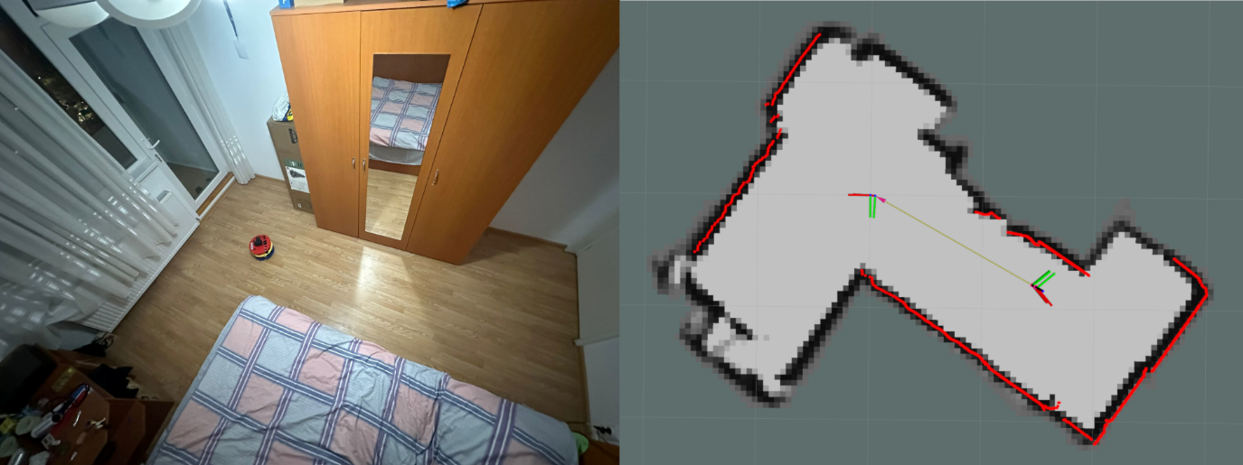
Map generated by Cartographer

Slide 16
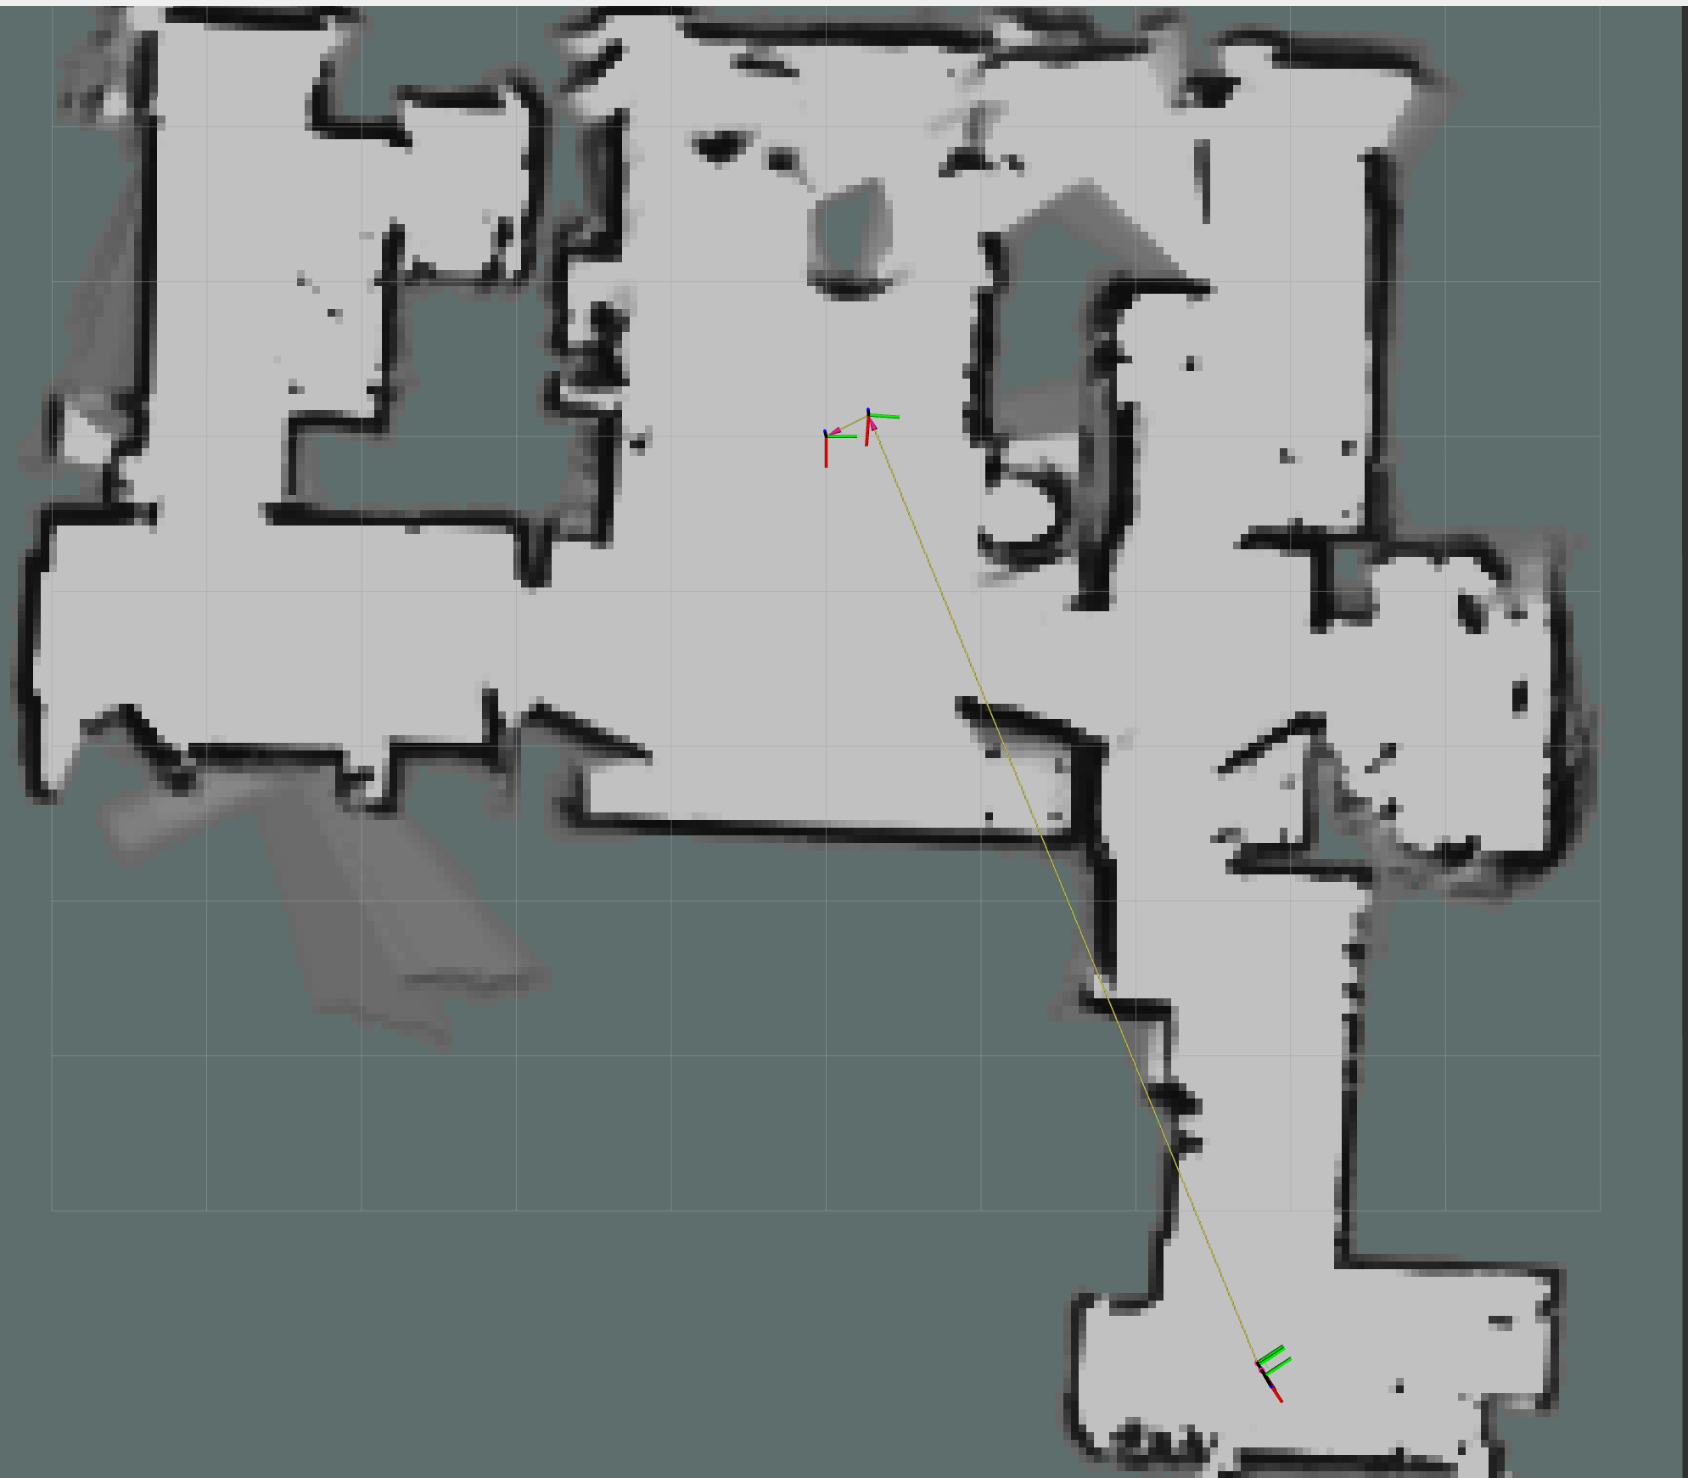
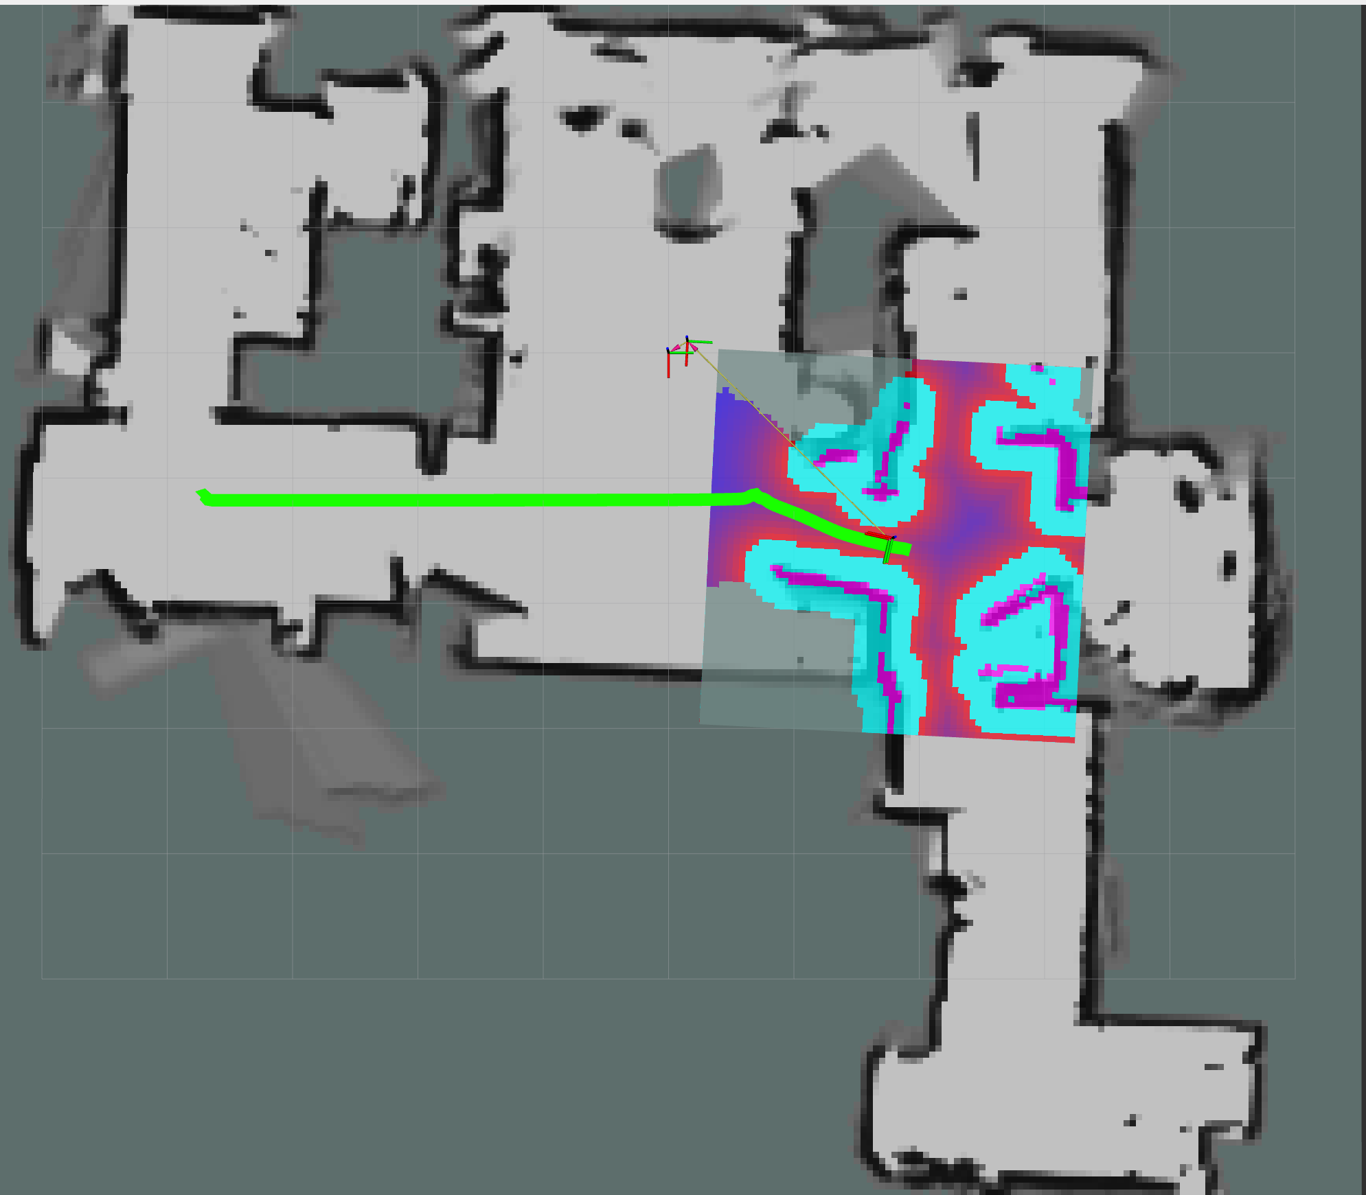
Map generated by Cartographer

Slide 17
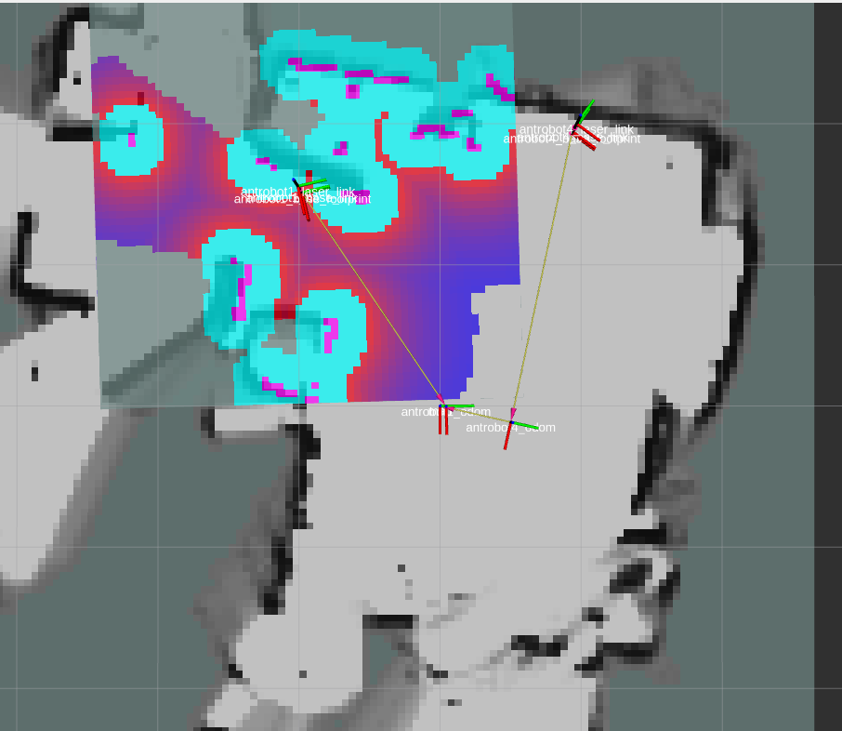
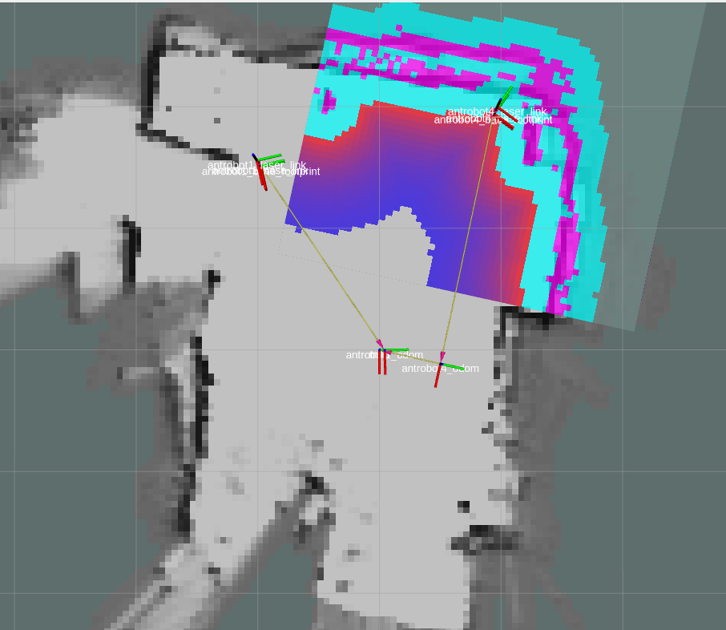
Global and Local Costmaps

Slide 18
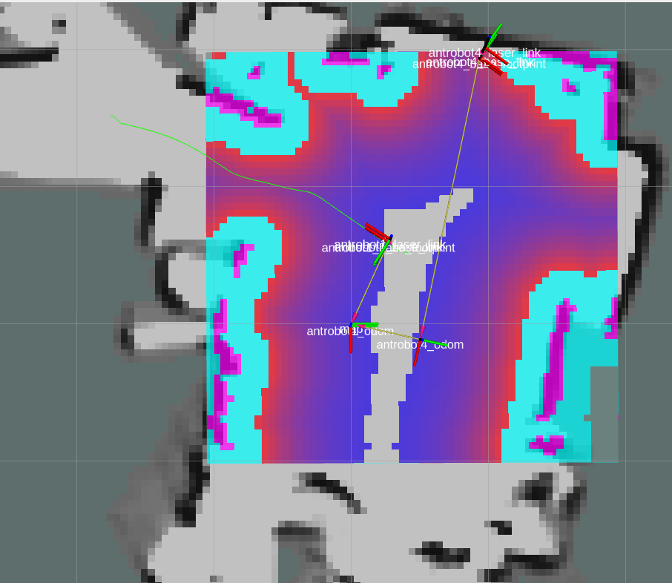
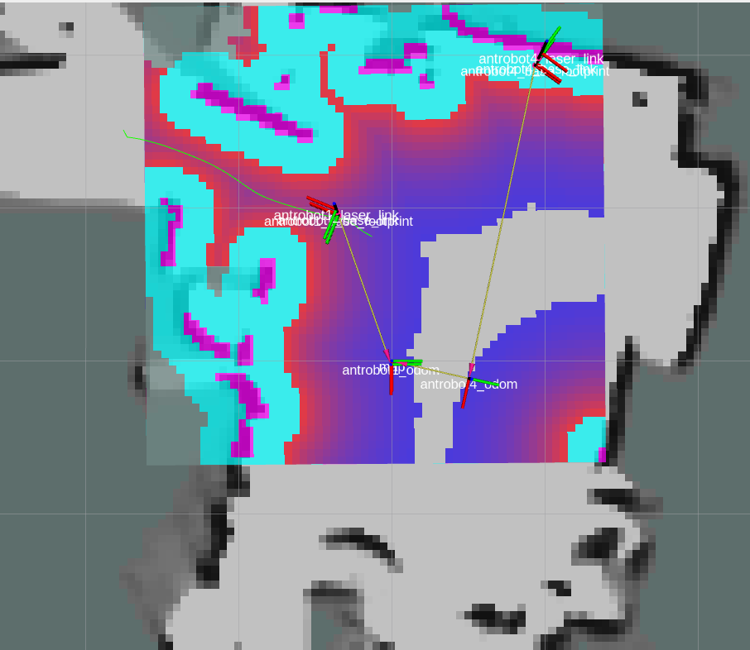
Path generated

Slide 19
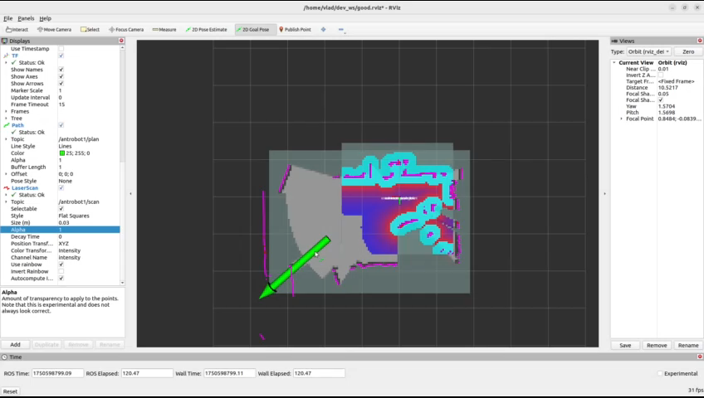
DEMO

